Slide 1
Putting Data in It’s Place
A Survey of Data Placement Algorithms
By
Troy Dey

Slide 2
Background
The amount of data organizations handle continues to grow rapidly
The rise of Big Data and the commoditization of ML algorithms has led to organizations of all sizes seeking insights into their data
The public cloud which offers many different storage services
IoT systems that are constantly generating data
In order to balance, performance, capacity, and cost storage systems vendors create products consisting of multiple devices

Slide 3
Diversity of Devices
Device vendors have been creating more specialized devices to meet the needs of specific aspects of storage
HDD with SMR are now being shipped which allow increased capacity for HDD at the expense of write performance
Storage Class Memory (NVRAM) provides byte addressability, near DRAM level performance with greater capacity, but is still much more expensive than SSD’s.
SSD’s have become much cheaper, but they are still more expensive than HDD’s and have durability constraints
SSD’s have also increased in capacity but these larger capacity devices also have worse endurance

Slide 4
Device Hierarchy
https://blog.dellemc.com/en-us/memory-centric-architecture-vision/

Slide 5
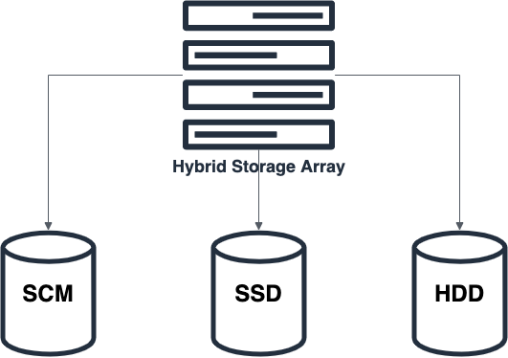
What is Placement?
In a storage system containing multiple storage pools with different capabilities and a workload which accesses data in a certain pattern what is the optimal pool that each block of data should be stored on?
The goal is to achieve the highest performance at the lowest cost for the given workload

Slide 6
Caching V Placement
Copying V Moving
Eviction and write back/through V Migration
Near real time V Periodic
Simple heuristic V Complex Heurist, Optimization, Machine Learning
Simple workload characteristics V Complex workload heuristics
A single pool acts as the cache V All pools need to be considered

Slide 7
Key Questions
What is the workload being placed?
What system is placement is occurring on?
What is the unit of migration?
What characteristics of the workload will be used to generate a placement recommendation?
Will device characteristics be considered?
How will the placement adapt to changes in the workload?

Slide 8
What is the workload being placed?
Many placement algorithms are designed to be general purpose
Placement can also be designed for more specialized purposes
Virtual Machines
Databases
Hadoop
Key Value

Slide 9
What system placement is occurring on?
Storage array, Cloud, Hybrid, multiple arrays
How are the pools organized?
Hierarchical
Fully Connected
All part of a single rack or across data centers

Slide 10
What is the unit of migration?
Has a major impact on the design of the algorithm
Block V File Level
Block
Smaller migration size
More efficient placement
Larger amount of metadata required
Can be tracked as chunks/slices of contiguous blocks
File
Large migration size
Less efficient
Smaller metadata overhead
Take advantage of application level metrics

Slide 11
Workload Characteristics?
Which characteristics to track in order to determine placement
Basic
IOPS, throughput, latency
Advanced
Sequential V random
Read/Write ratio
Sync v Async
The more characteristics used the more
Complex the algorithm
More compute overhead needed
More storage needed

Slide 12
Will device characteristics be considered?
More complex algorithm
More metadata needed
More knowledge of the system needed
Can take advantage of the unique characteristics of different types of devices
Large percentages of data are written once and never accessed: place on HDD
Small percentage of data receives nearly half of the I/O: place on SCM
Small random writes: place on SCM
Data that is frequently accessed in large sequential chunks: place on SSD

Slide 13
How will the placement adapt to changes in the workload?
How are characteristics collected?
High frequency can lead to unacceptable overhead
How frequently are migrations allowed to happen?
Migrations are very expensive and could disrupt normal system operation
How does the algorithm adapt to changes?
Too complex and the overhead can be unacceptable
Too simple and the placement can be poor, lead to thrashing

Slide 14
Chew Analyzer
Directly addresses placement in a system containing multiple pools each consisting of a different type of device
Considers a system where all the pools are directly connected
In depth workload analysis considering aspects such as sequential v random, read/write ratio, etc.
Finds that nearly 30% of data receives 0 accesses and 10% receives close to 50%
Unit of Migration: a chunk of contiguous blocks
Use a hierarchical classifier to determine block placement

Slide 15
K-SVM
Addresses the adaptability problem
A traditional storage array with an HDD capacity tier and an SSD performance tier
Simple workload characteristic, only considers access intensity
Unit of Migration: Slice of contiguous blocks
Utilizes K-Means to select a training set for the SVM algorithm
Uses SVM to classify slices into hot and cold
Studies the impact of different parameters such as slice size, bandwidth, PT to CT ratio

Slide 16
AutoTiering
Designed for an All Flash Array containing multiple pools of different types of flash devices running Virtual Machine workloads
A performance tier consisting of SLC or Optane SSD’s and a capacity tier consisting of TLC SSD’s
Workload characteristics are IOPS, throughput, latency
Considers devices characteristics at a basic level
Unit of Migration: VMDK file
Uses benchmarking tool running in each VM to inject latency at runtime to estimate the impact of running the VM on different tiers
Formulates the problem as an optimization problem and uses a greedy approach to solving a simplified version

Slide 17
CAST
Placement for MapReduce style workloads running in the cloud
Cloud offers a wide variety of storage services with characteristics that are unique to the cloud environment such as ephemeral devices and performance being based on capacity allocated
MapReduce jobs also exhibit unique characteristics that can be taken advantage of to improve placement
The main workload characteristic under consideration is the runtime for the job
Unit of Migration: Job
Optimization framework using regression to estimate job runtimes on different storage configurations and simulated annealing to explore the configuration space and find a near optimal solution
Runs offline
Considers cost

Slide 18
Ziggurat
A tiered file system designed specifically for systems containing SCM
Needs to make real time decisions for each I/O
Provide near SCM performance
Unit of Migration: Write Entry
Use SCM to absorb small random writes and synchronous writes
Steer large async writes to SSD
Migration consolidates writes in SCM and migrates them in large chunks to SSD

